Slide 1

Sebin joy
MCA

Slide 2
Contents
Abstract
Modules
Existing System
Proposed System
Table Design
Diagrames
Forms
Conclusions

Slide 3
The image processing software is a windows form project developed in visual studio 2010
The main goal of this project is show and explains the easiest way how implement a face detector and recognizer in real time for multiple persons using Principal Component Analysis with Eigen face for implement it in multiple fields.
Facial recognition is a computer application composes for complex algorithms that use mathematical and matrical techniques, these get the image in raster mode(digital format) and then process and compare pixel by pixel

Slide 4
The project include 3 processes
face detection
face recognition
compare images

Slide 5
MODULES
Face Detection:
In the “Face detection” process. Multiple faces are identified in real time. Using a ordinary Web camera .The opencv library help us to grab the frames from the cam buffer. And allow us to search for a specific pattern “face”.

Slide 6
Facial Recognition:
Facial recognition is a computer application composes for complex algorithms that use mathematical techniques, these get the image in raster mode(digital format) and then process and compare pixel by pixel.

Slide 7
Compare Images:
In the “compare images” process. Two
images are compared using C#.net image processing library. The library procedure decode the image. Extract the binary data of the image compare it bit by bit. Then archive the binary data. Encode it into image format

Slide 8

We are doing our project in ASP.NET Building tools are :
Visual Studio 2010
GITHub
ASP.NET is a web application framework developed and marketed by Microsoft to allow programmers to build dynamic web sites.
It allows you to use a full featured programming language such as C# or VB.NET to build web applications easily.

Slide 9

This technique uses 3-D sensors to capture information about the shape of a face. This information is then used to identify distinctive features on the surface of a face, such as the contour of the eye sockets, nose, and chin.
It can also identify a face from a range of viewing angles, including a profile view.

Slide 10

3D facial recognition needs a 3d camera to operate.
Only work on ultra light sensitive camera.
It requires more time.
Cost is high

Slide 11

The aim of proposed system is to develop a system of improved facilities. The proposed system can overcome all the limitations of the existing system in a cost effective way.
The system is very fast as compared to the another.

Slide 12
Table_attendence
Field | Dtatype | Constraints
id | int | Primary key
Name | Varchar
department | varchar
date | date
rollno | int

Slide 13
Data flow diagram
Context level
Face detection attendance system
User
Tbl_attendencde

Slide 14
Level 1
Login
Tbl_login
User
Face detection
Face recognition
Add attendence
Tbl_attendence

Slide 15

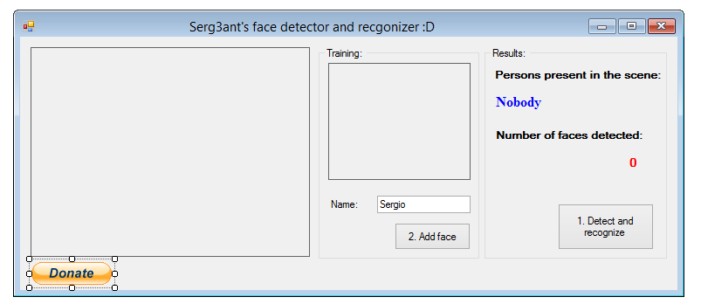

Slide 16


